Slide 1
Simplify technical language

Slide 2

OBJECTIVES FOR THIS SESSION
Clarify the level of IT understanding of your audience
Simplify technical language
Adapt your speech according to your audience

Slide 3


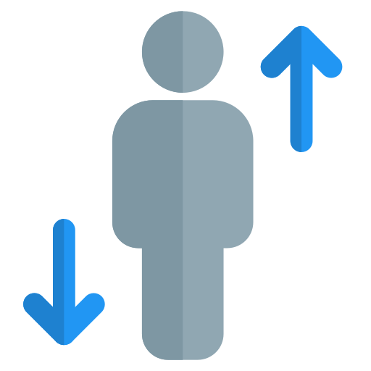
ENGAGE
Seat or stand-up!
10 MIN
Does the audience of these events have a good level of IT understanding?

Slide 4

Matching definitions
ACTIVITY 1
20 MIN
Click on the link and match the words and their definitions

Slide 5

Specify your speech
ACTIVITY 2
15 MIN
You will say the sentence you receive in a presentation.
Is it technical or simplified language?
Go in the right section of the room
Students from the non-IT section read their sentence and match with the student from the IT section.
Technical sentence
Simplified sentence

Slide 6


Examples of simplified sentences
EXPLAIN
10 MIN
Technical sentences
Our new website uses adaptive design to ensure that it looks good on all devices.
Our website uses a grid layout to position the elements on the page.
We use a JavaScript library to add a carousel to our homepage.
Our website uses progressive enhancement to ensure that it is accessible to everyone
Simplified sentences
Our new website is designed to look good on all devices, from smartphones to desktops.
Our website uses a layout system to position the elements on the page in a way that is easy to read and understand.
We use a pre-written code library to add a slideshow of images to our homepage.
Our website is designed to be accessible to everyone, regardless of the browser or device they are using.

Slide 7
Role play!
ACTIVITY 3
30 MIN
Pick a scenario and perform a role play! After the role play, do your self evaluation and give feedback to your peer.
1
PREPARATION
(15 min)
2
ROLE PLAY
(5 min)
3
SELF- EVALUATION & PEER REVIEW
(10 min)
TO COMPLETE THIS ACTIVITY :

Slide 8
HOMEWORK
Rewrite those sentences in simplified language:
We use a Python library to manage our database connection pool.
We use a Python dependency manager to install and manage our Python dependencies.
We use a Python framework to create our web application.
We use a Python testing framework to test our code.

